Slide 1

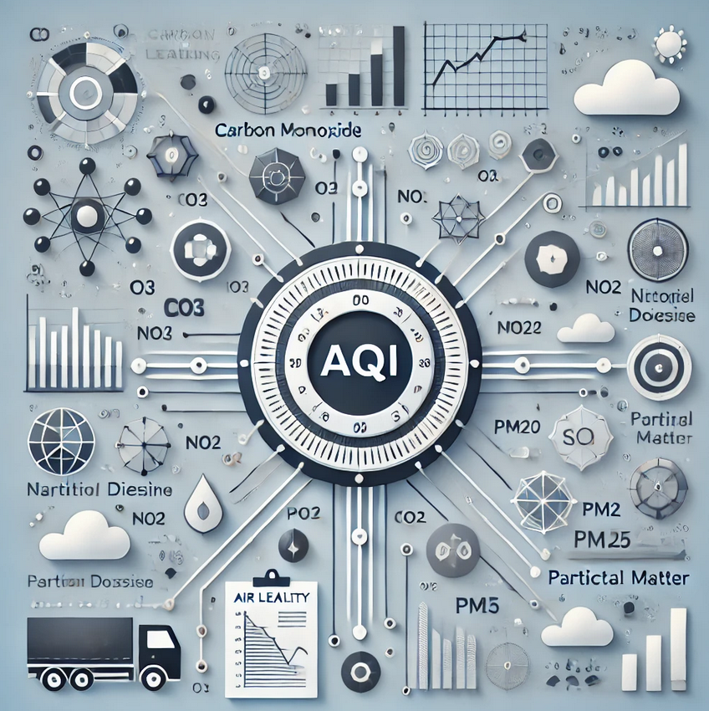
Air Quality Prediction
Predicting AQI based on pollutant levels (CO, O3, NO2, SO2, PM10, PM2.5)
Arman Ghaziaskari Naeini
December 2024

Slide 2
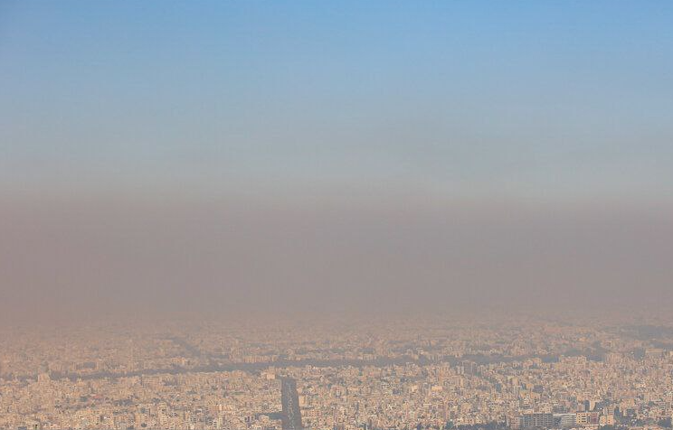

What is Air Quality?
Air quality is crucial for public health due to its direct impact on respiratory and cardiovascular conditions.
AQI (Air Quality Index): A common measure used to indicate air pollution levels.
Key Pollutants: The primary pollutants affecting air quality include:
CO (Carbon Monoxide)
O₃ (Ozone)
NO₂ (Nitrogen Dioxide)
SO₂ (Sulfur Dioxide)
PM10 (Particulate Matter 10)
PM2.5 (Particulate Matter 2.5)
Understanding air quality is essential for developing effective pollution management strategies.

Slide 3
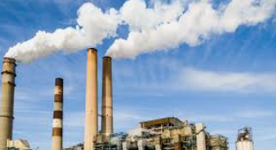
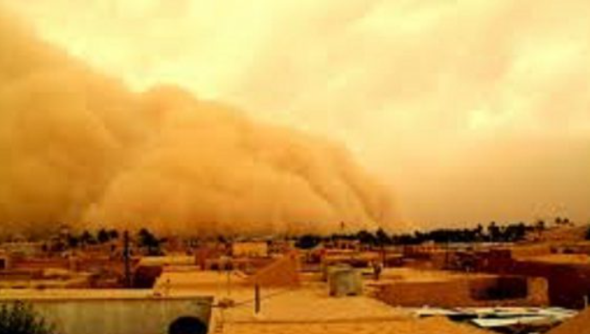
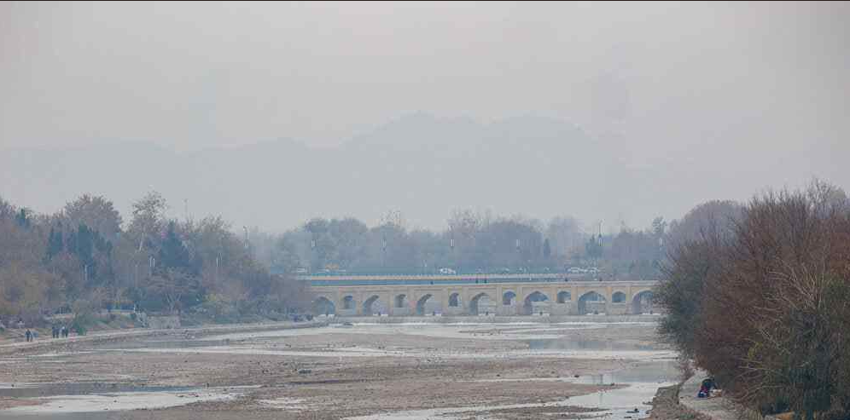
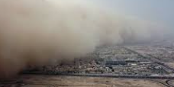

Key Features Affecting Air Quality
SO2 (Sulfur Dioxide):
PM10 (Particulate Matter 10):
PM2.5 (Particulate Matter 2.5):
Volcanic gas or sulfufric burning in fossil fuel
Particles can penetrate the lungs. produced by Dust, wildfires and brush/waste burning, industrial sources.
Industry and fuel oil, construction site, transboundary, industry, open burning or Traffic

Slide 4
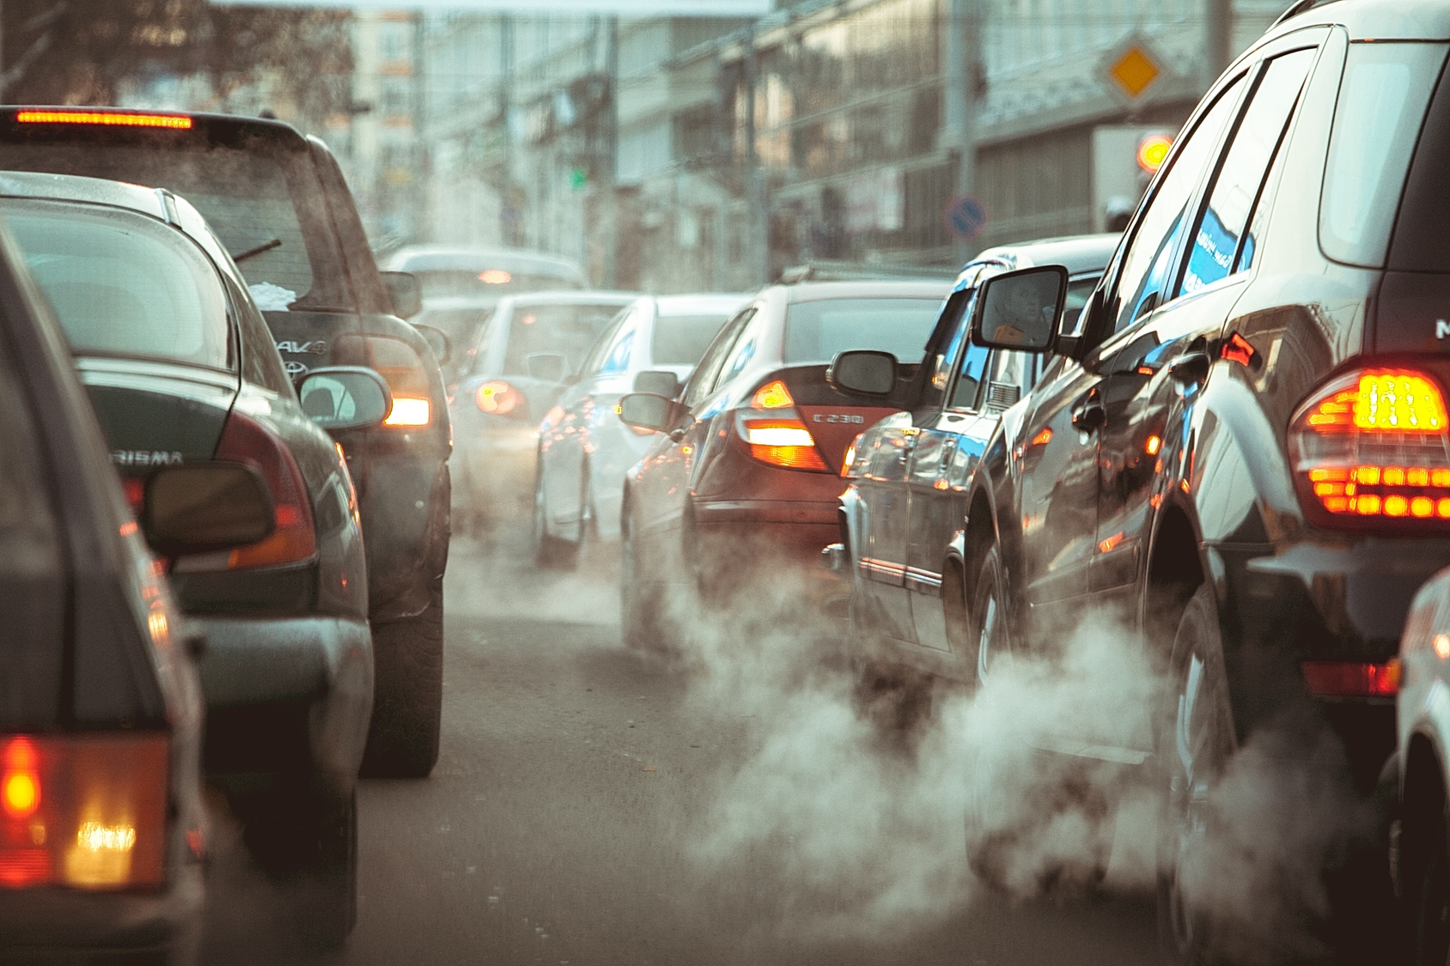
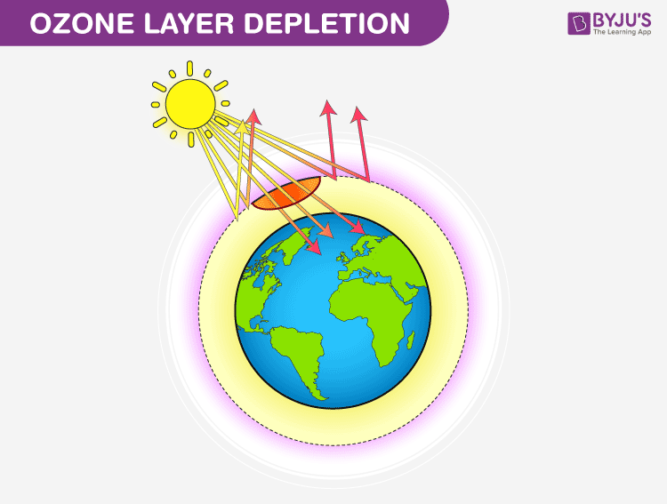
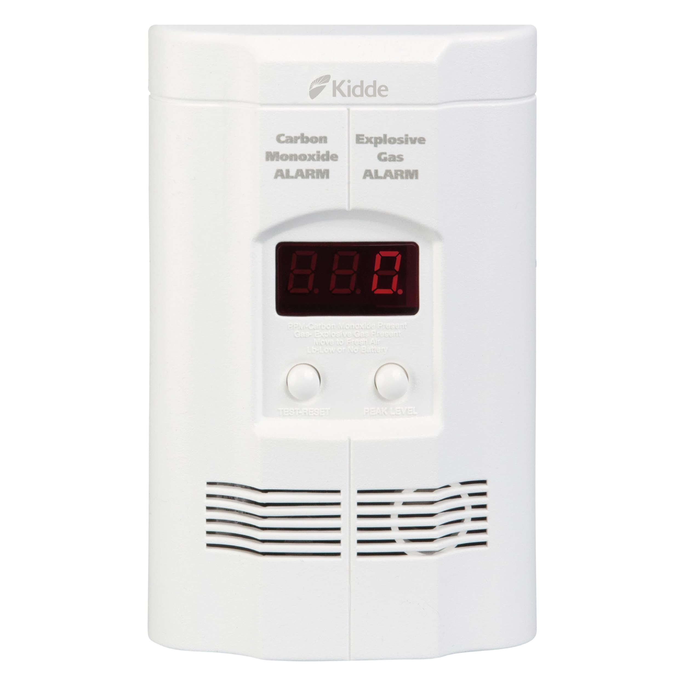
Key Features Affecting Air Quality
Nitrogen Dioxide (NO2)
Ozone (O3)
Carbon Monoxide (CO)
Forest fire, methane nitridation, biological activity or incomplete combustion of fuel.
formed during the process of nitride combustion. Nitride is the product of nitrogen oxide photochemical reaction.
Secondary pollutants from nitrogen oxide, reactive hydrocarbons, or photochemical reaction.

Slide 5
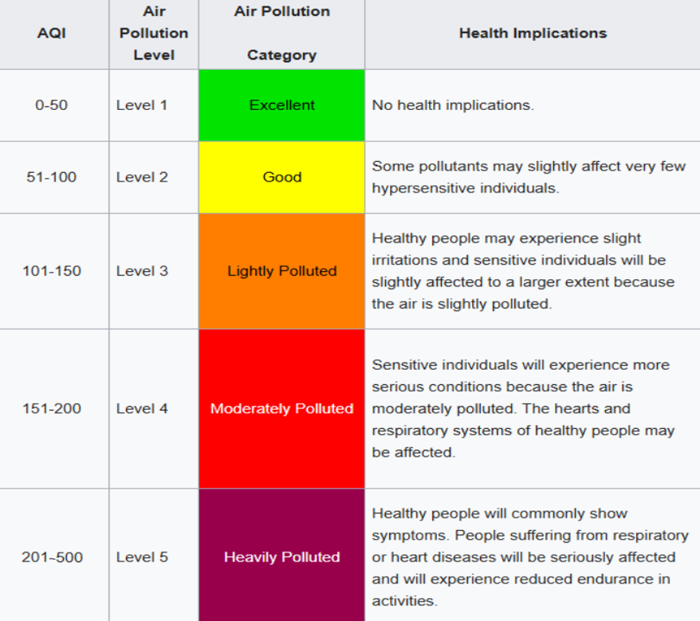
Data Source
Dataset from Iranian Environmental Organizaion
2123 Air polution stations
Metrics included:
CO (Carbon Monoxide)
O3 (Ozone)
NO2 (Nitrogen Dioxide)
SO2 (Sulfur Dioxide)
PM10 (Particulate Matter 10)
PM2.5 (Particulate Matter 2.5)
Target:
AQI (Air Quality Index)
Creating 2 targets :
AQI Description
AQI Average

Slide 6
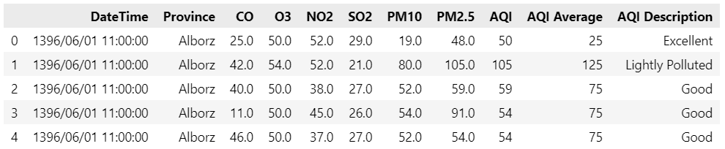
Problems in the data
Missing Values: Resolved using the median.
Duplicated Rows: Removed.
Column Names and Contents: Originally written in Persian; converted to English.

Slide 7
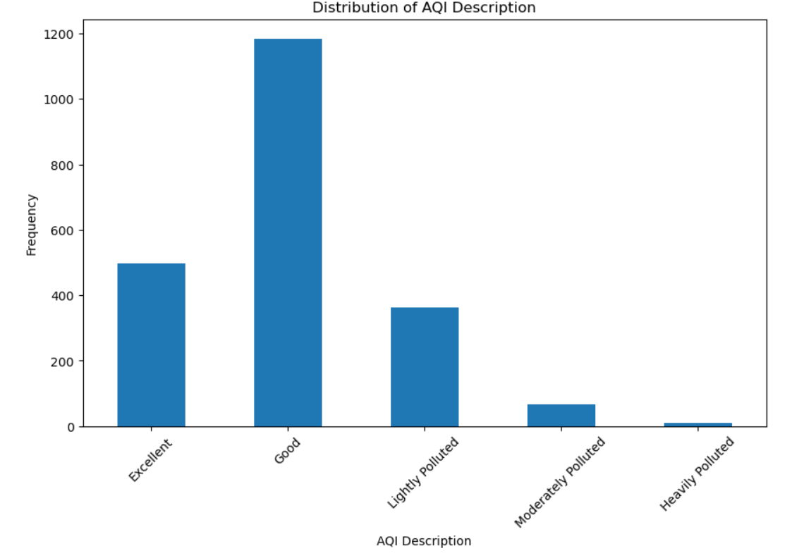
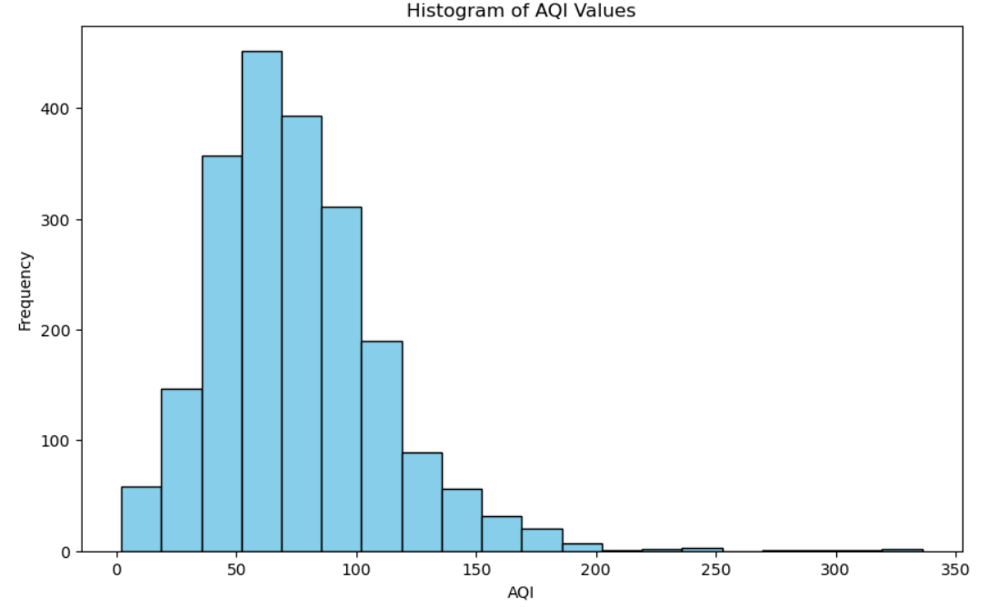
AQI

Slide 8
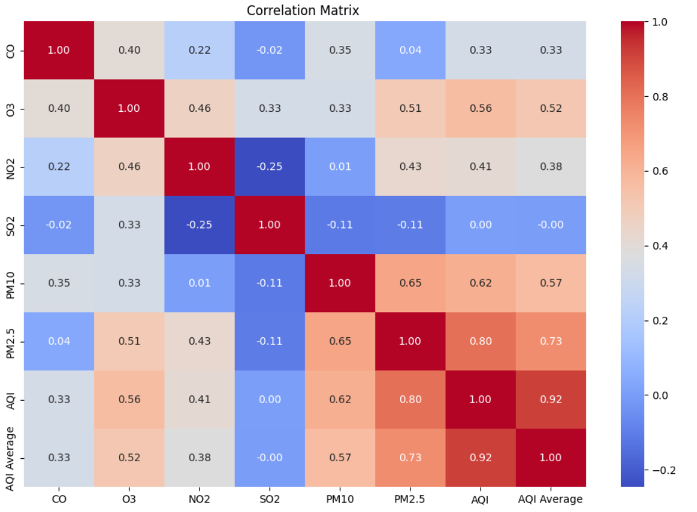
Heatmap

Slide 9
Regression
Rank | Model | MAE | R² | Hyperparametrs
1 | Gradient Boosting | 4.576557 | 0.909186 | learning_rate : 0.05, max_depth : 10, min_samples_split : 10, n_estimators : 300, subsample : 0.8
2 | Random Forest | 4.947887 | 0.905484 | max_depth : None, max_features : None, min_samples_leaf : 1, min_samples_split : 2, n_estimators : 300
3 | XGBoost | 4.962615 | 0.905852 | learning_rate : 0.1, max_depth : 7, n_estimators : 150, subsample : 0.8
4 | KNN | 5.127256 | 0.873260 | metric : manhattan , n_neighbors : 2, weights : distance
5 | Decision Tree | 5.332536 | 0.857144 | criterion : squared_error , max_depth : None, max_features : None, min_samples_leaf : 1, min_samples_split : 2
6 | SVR | 6.478604 | 0.813697 | C : 100, degree : 1, gamma : auto , kernel : rbf
7 | ElasticNet | 13.003160 | 0.693486 | alpha : 0.7543120063354622, l1_ratio : 1.
8 | Lasso | 13.003974 | 0.693382 | alpha : 0.774263682681127
9 | Linear Regression | 13.018671 | 0.691836 | -
10 | Ridge | 13.018671 | 0.691836 | alpha : 0.0001

Slide 10
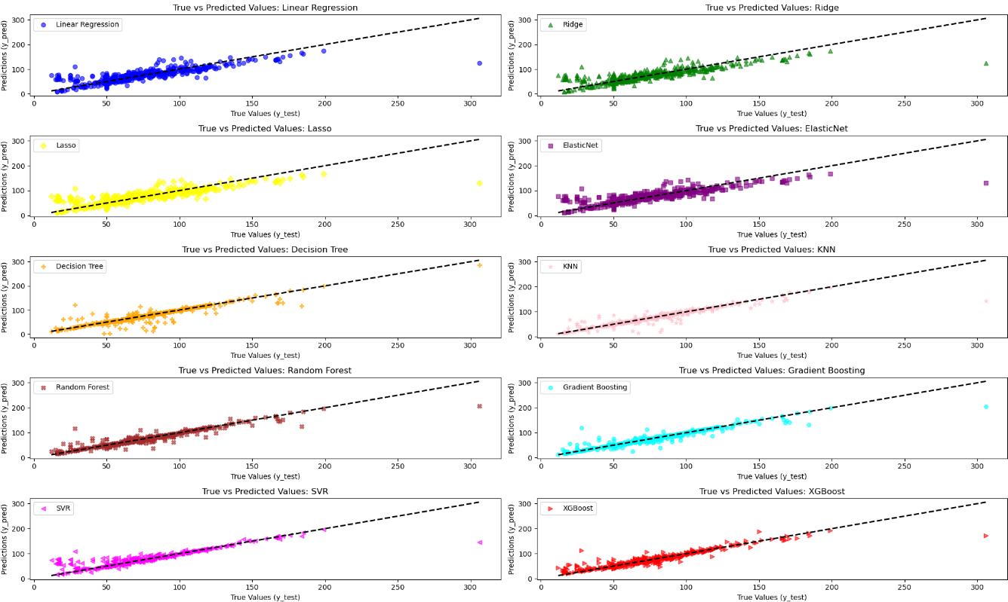
Regression

Slide 11
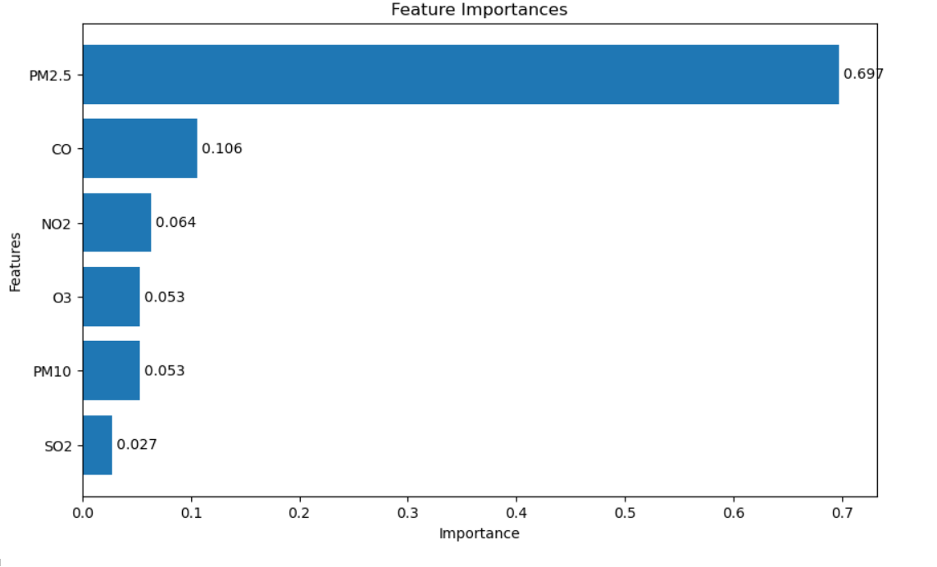
Regression
Controlling PM2.5 emissions should be the primary focus for improving air quality.
CO's contribution highlights the need to monitor traffic emissions and combustion activities more closely.
NO2 (Nitrogen Dioxide), O3 (Ozone), and PM10 have relatively low importances.
These pollutants still influence air quality but are less significant compared to PM2.5.
Feature | Importance
PM2.5 | 0.697276
CO | 0.105519
NO2 | 0.063716
O3 | 0.053219
PM10 | 0.053100
SO2 | 0.027170
Gradient Boosting

Slide 12
Classification
Model | Accuracy | F1-score | ROC AUC | Recall | Best Params
Gradient Boosting | 0.9426 | 0.9840 | 0.7251 | 0.7222 | learning_rate : 0.1, max_depth : 7, n_estimators : 100, subsample : 0.8}
XGBoost | 0.9330 | 0.9715 | 0.7285 | 0.7266 | colsample_bytree : 0.8, learning_rate : 0.1, max_depth : 7, n_estimators : 50, subsample : 0.8
Random Forest | 0.9282 | 0.9897 | 0.7219 | 0.7103 | max_depth : None, max_features : sqrt , min_samples_leaf : 1, min_samples_split : 2, n_estimators : 200
KNN | 0.9258 | 0.9444 | 0.9268 | 0.9131 | metric : euclidean , n_neighbors : 1, weights : uniform
Decision Tree | 0.9067 | 0.8367 | 0.7081 | 0.7029 | criterion : entropy , max_depth : None, min_samples_leaf : 1, min_samples_split : 2}
SVC | 0.8612 | 0.9707 | 0.6777 | 0.6713 | C : 10, gamma : scale , kernel : rbf
Logistic Regression | 0.7727 | 0.8662 | 0.6108 | 0.5854 | C : 11.288378916846883, solver : lbfgs

Slide 13
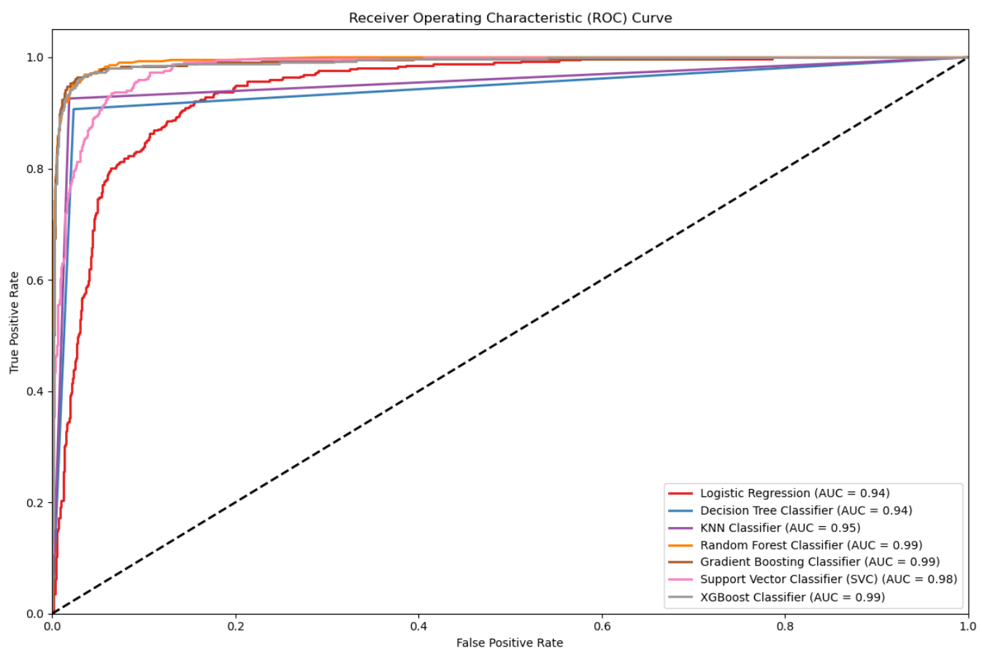
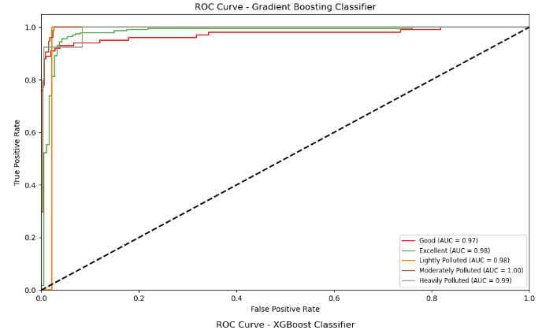
Classification

Slide 14
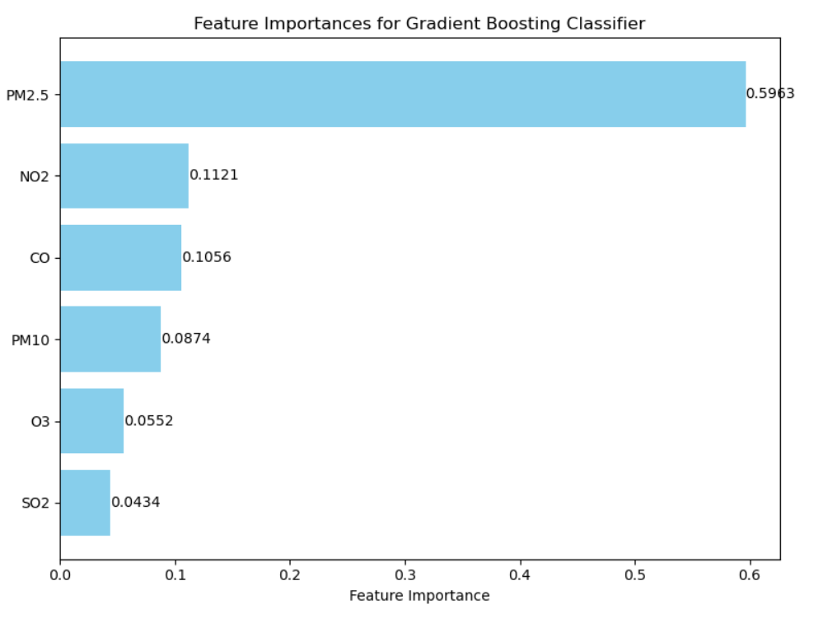
Classification
Feature | Importance
PM2.5 | 0.596267
NO2 | 0.112122
CO | 0.105613
PM10 | 0.087409
O3 | 0.055173
SO2 | 0.043416
Gradient Boosting

Slide 15
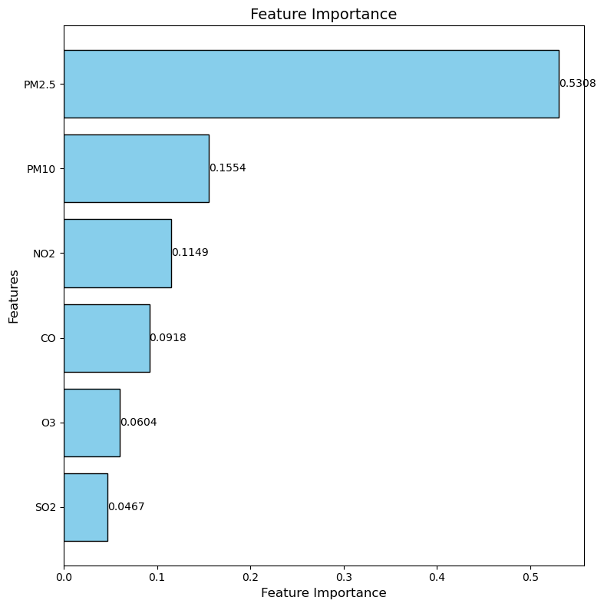
Deep Learning-MPLs-Classification
Best Hyperparameters:
batch_size=16,
dropout_rate=0.4
epochs=550
learning_rate=0.01,
neurons_layer1=32
neurons_layer2=16
PM2.5 | 0.5308
PM10 | 0.1554
NO2 | 0.1149
CO | 0.0918
O3 | 0.0604
SO2 | 0.0467

Slide 16
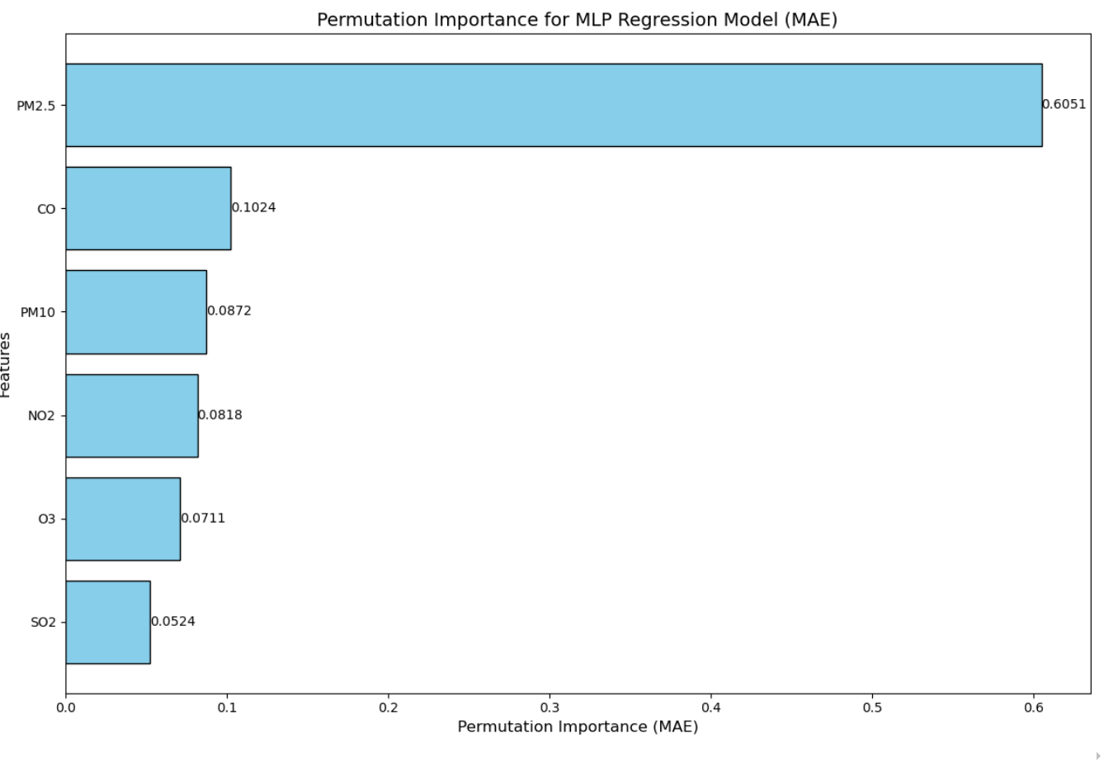
Deep Learning-MPLs-Regressiom
Best Hyperparameters:
batch_size: 22
epochs: 381
dropout_rate: 0.11060969310248417
learning_rate: 0.0018505523167281056
neurons: 122
PM2.5 | 0.6051
CO | 0.1024
PM10 | 0.0872
NO2 | 0.0818
O3 | 0.0711
SO2 | 0.0524

Slide 17
Regression
MPLs
GB

Slide 18
Regression
Both models agree on the primary role of PM2.5 in AQI prediction, underscoring its generalizability across methods.
Health and Policy Implications: The prominence of PM2.5, CO, and PM10 aligns with their known adverse health effects, underscoring their importance in air quality management policies.

Slide 19
Classification
MPLs
GB

Slide 20
Classification
PM2.5 consistently leads in importance, emphasizing its health and environmental impact.
Gradient Boosting models tend to assign higher importance to CO and NO2 compared to MLP models.
MLP models capture a slightly higher role of PM10, suggesting sensitivity to non-linear relationships.

Slide 21
Conclusion
DomPM2.5 is the Most Important Feature
PM2.5 is consistently the top feature in all models, showing its strong impact on air quality and human health.
Model Performance Highlights
Gradient Boosting: Best performance with the lowest MAE (4.576557) in regression and the highest accuracy (94.26%) in classification.
MLP Models: Showed good results and flexibility in analyzing feature importance.

Slide 22
Future Directions
Focus on an Area and Extend the Dataset
By focusing on a specific area, we can identify localized patterns, such as seasonal trends, traffic density, or industrial pollution.
Extend the Dataset to Include Meteorological Factors
e.g., temperature, humidity, wind speed..
Using Time Series Data to Predict AQI Behavior
To predict AQI both over time and space.

Slide 23
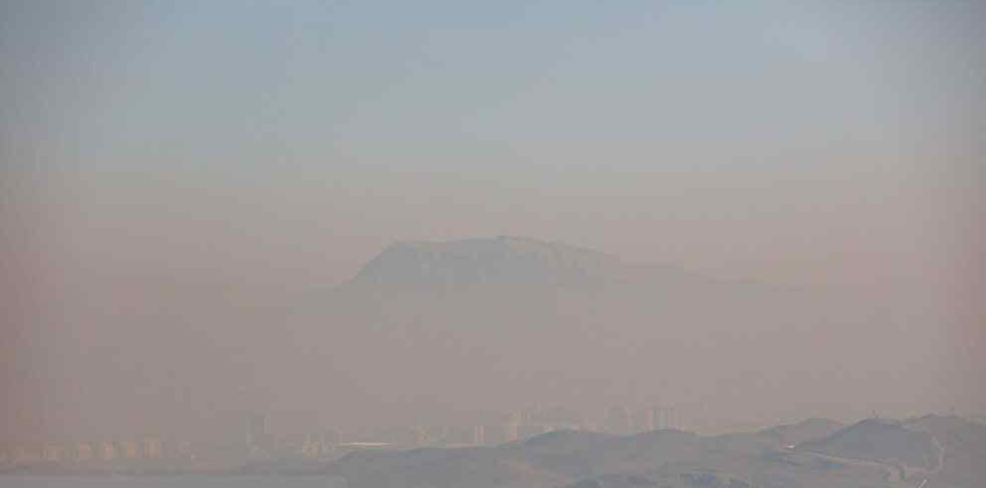



Thanks for your attention
Eskerrik asko zure arretagatik

